Slide 1
Find it….
Notes:
Hello- Today Aimee Tollett, Muna Ahmed, Malcom Felton, and myself, Ivey Lee are going to discuss Find IT

Slide 2
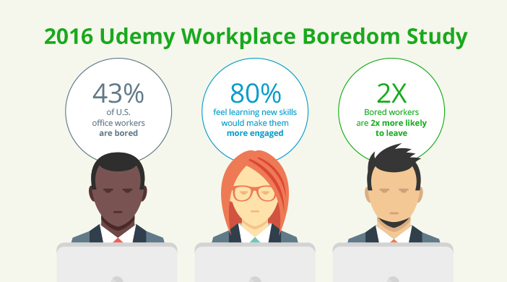
Notes:
To begin, with many people at home due to the pandemic. We wanted to go back to another time. In 2016 Udemy Workplace did a study and found that 43% of office workers are bored. I am not sure how that applies to Developers. 80% feel learning a new skill would make them more engaged. Great job as we all chose to take action and are in this class today. Last, bored workers are 2x more likely to leave. Fast forwarding to today, we are not in offices but at home.

Slide 3
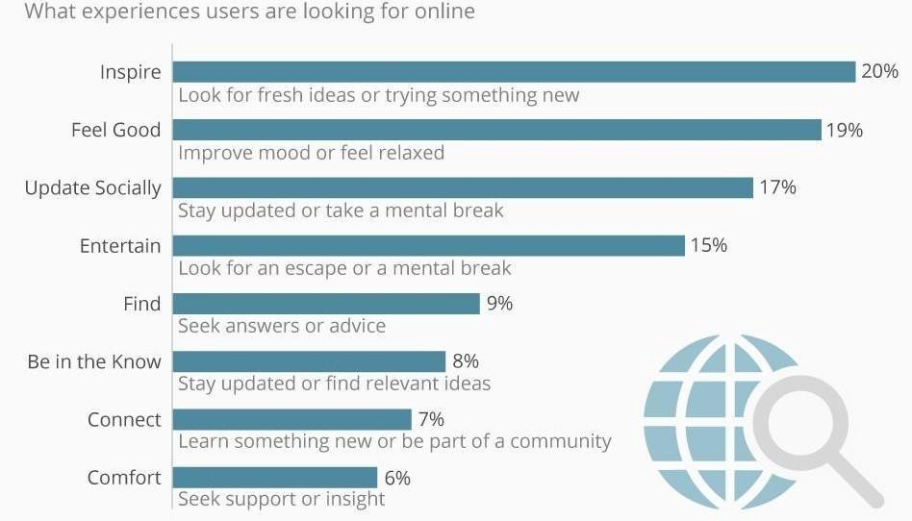
https://medium.com/sminq/the-footprint-of-the-internet-towards-healthcare-b5138d24afac
Notes:
While we are at home, May 2019, Medium did a study of online search queries and found that online searches are about being Inspired, feel good, update socially ,entertain, find, be in the know, connect, and comfort. This led us to focus on helping people entertain, feel good, and inspire. Those 3 are 54% of the searches Medium studied. We want to help you Find It……

Slide 4
Project Overview
Minimum Viable Product |  |  |  |  |  | Products
2 APIs Server Side APIs | Back End | Complete |  |  |  | News API
CSS Included | Front End | Complete |  |  |  | Ecommerce Login
1 3rd Party API | Back End | Complete |  |  |  | Combination and Subscribe option
Mobile First UI | Front End |  |  |  |  | Restaurant food price comparison
No Alerts/Confirms/Prompts |  | Complete |  |  |  | Entertainment API
Interactive | Front End | Complete |  |  |  | Start with Books
Project 1- | Owners | Description | Due Dates |  |  | Check In Dates
Set up Project Repo | Aimee | Complete | 18-Jul |  |  | All Class times
Protect Master Repo | Aimee | Complete | 18-Jul |  |  | Addition-
Branching and Pushing | Aimee/Muna | Complete | 18-Jul |  |  | 20-Jul
Divide in Groups | Group AIMM | Complete | TBD |  |  | 22-Jul
PRFAQ | Aimee | Complete | TBD |  |  | 27-Jul
Wireframe | Ivey | Complete | TBD |  |  | 29-Jul
User Workflow | TBD | Complete | TBD
M1- Submit Project | Group AIMM- Aimee | Complete | 20-Jul
M2- Find APIs | Aimee/Muna/Ivey | Complete | TBD
Rebuild/Rebrand | Malcom | Complete | TBD
Add API to CSS | Malcom/Aimee | Complete | TBD
Craft Elevator Pitch | Ivey | Complete | TBD
M3-Presentation | Group- AIMM | 1-Aug | 30-Jul
Notes:
We began working and started our focus on books. Not just any books but cheap books. We carved out the work and began to dive in. Set dates on when we wanted to meet, parameters of the MVP, task owners, and due dates. The APIs we started with were Amazon API, Goodreads, and Open Book API. None worked and we landed on the Google Books API.
What we discovered is we are nice people. Not a bad thing but we agreed on everything. As you can see many of our dates are TBD. We completed it all so that is what matters. About 75% of the way to goal, an idea of moving beyond books to include music and movies. We then encountered the same issue with music. Started with Shazam API, then Music Match, and now Deeter. This is the result

Slide 5
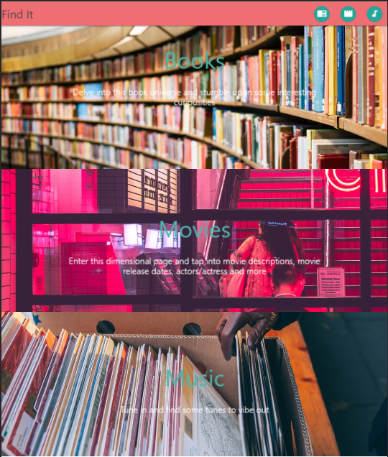
Notes:
We did it, and it came together quite well I say. Next time we work on a project, we are definitely going to speak sooner as this could’ve evolved even more! Seeing Find IT come to life was great. We have the ability to search for books and give you a description of the book and also show your lowest price via Google Books.
If you are curious about a movie related to the book, you can search and find the movie. While you cannot watch the movie and we know the movie does not always give the book justice but again we want to give you another entertainment choice.
You can Find It. Lastly Music, maybe you want the soundtrack or just a song you heard once before. You have the ability to search by Artist or Title.

Slide 6
Demo
Notes:
Enough talking, lets walkthrough it
DO NOT READ
Instructions: Walk through searches and play demo of music. Talk out load as you do it

Slide 7
Key Performance Indicators as we look ahead
Take an Instagram Baking Class
Catch Up on literary Classics
Join a virtual choir
Live-stream the Northern lights
Set up a home Karaoke Session
Wander the Netherlands most spectacular tulip garden
Read a beautiful art magazine
Host a virtual murder mystery
Get lost in a new podcast
Watch the skies
According to TimeOut: April 2020 https://www.timeout.com/things-to-do/best-things-to-do-at-home-stuck-inside-bored
Notes:
According to TimeOut, in April 2020- here are the top 10 activities they recommend you do while at home during the Pandemic. Please note, Catch up on a literary classic, Set up a home Karaoke Session, and Read a Beautiful Magazine are items we will help you with. Books, Music and Movies

Slide 8
RoadMap
Include more entertainment options
Nature
Seattle based Venues
Art, Museums, Aquarium
Include other books sources such as Amazon, ebook, Barnes and Noble, Books a Million
Seamless search experience
RSS feed for suggestions
Login with Google, Facebook, or Apple ID
Explore injection of SVOD and Online video services. Watch now ability
Notes:
As we look ahead. We want to ensure that we pick up on other entertainment options. Again we want to Inspire you, Help you feel good, and Entertain…
Our Roadmap includes. Nature, local venues, seamless search experience, and login with capabilities.

Slide 9
…Found It
Notes:
With that being said, we hope you Found It

